Slide 1
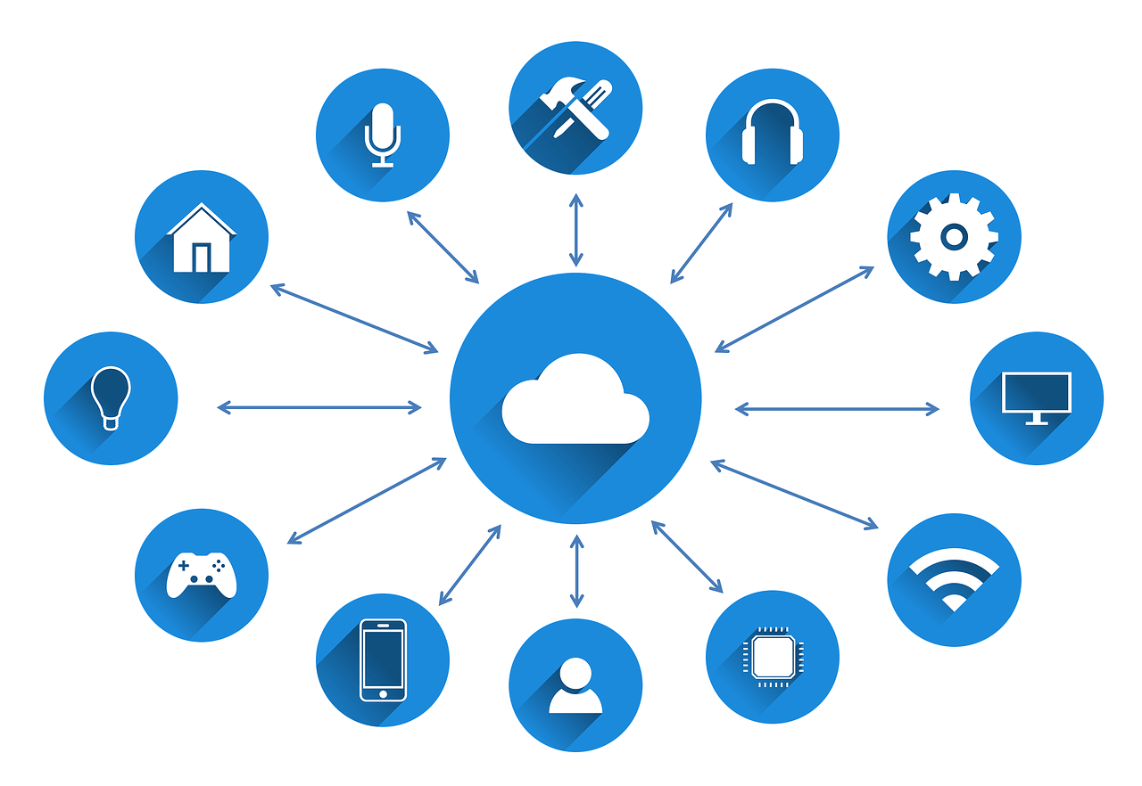
Automation using IoT

Slide 2
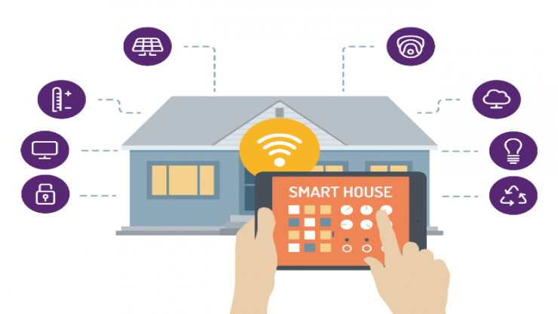
What is the Internet of Things?
The Internet of Things is the concept of connecting any device to the Internet and to other connected devices.
The IoT is a giant network of connected things and people – all of which collect and share data about the way they are used and about the environment around them.

Slide 3
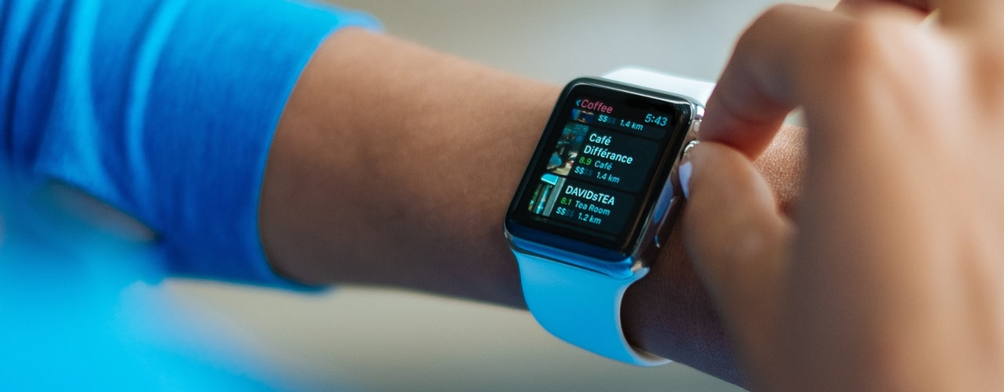
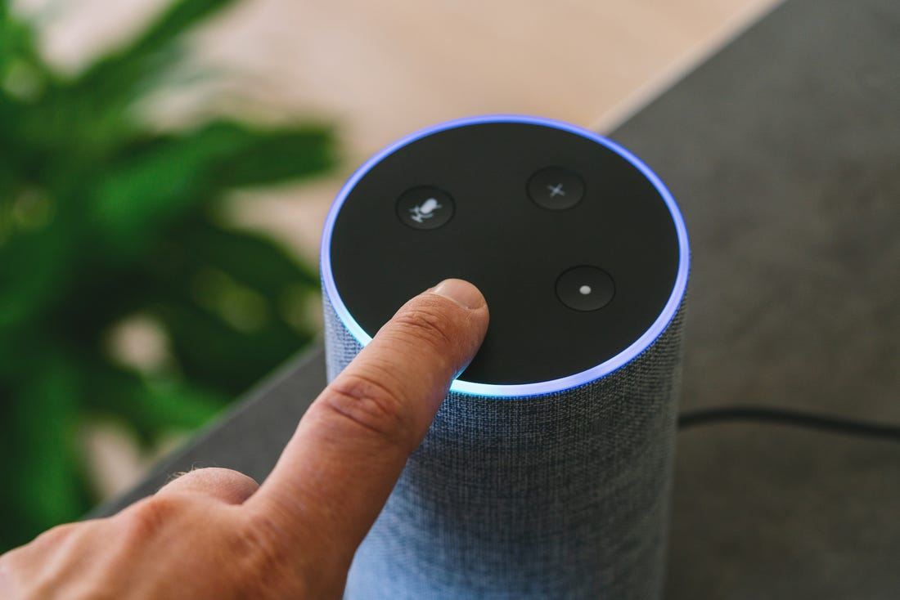
What are IoT devices?
Smart Mobiles, smart refrigerators, smart watches, smart fire alarm, smart door lock, smart bicycle, medical sensors, fitness trackers, smart security system etc., are few examples of IoT products.

Slide 4
How many IoT devices are there today?
According to Gartner :
In the year 2017 there were 8.4 billion IoT connected devices in the whole worldwide.
While in the year 2018 it increased to 9.2 Billion.
It is expected that in the year 2020 the IoT connected devices in the worldwide would be 20.8 Billion.

Slide 5
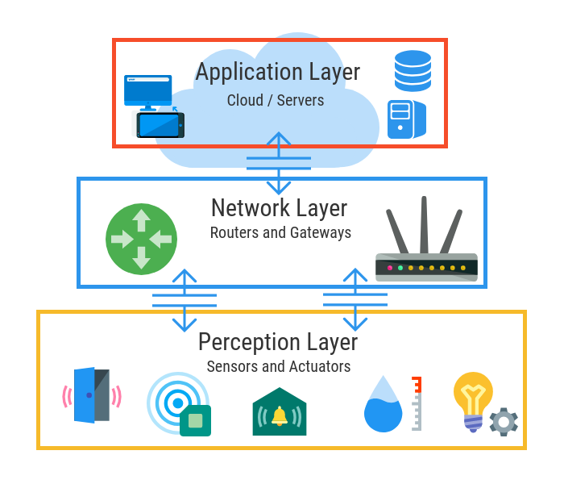
How does it work?

Slide 6
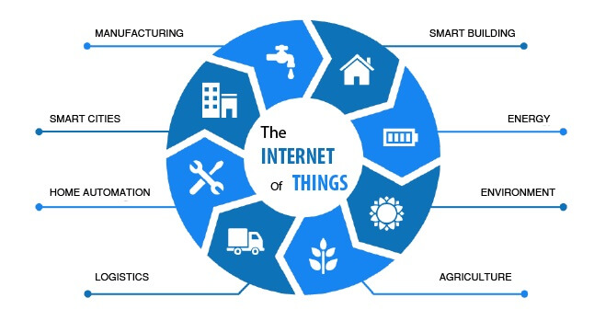

Slide 7
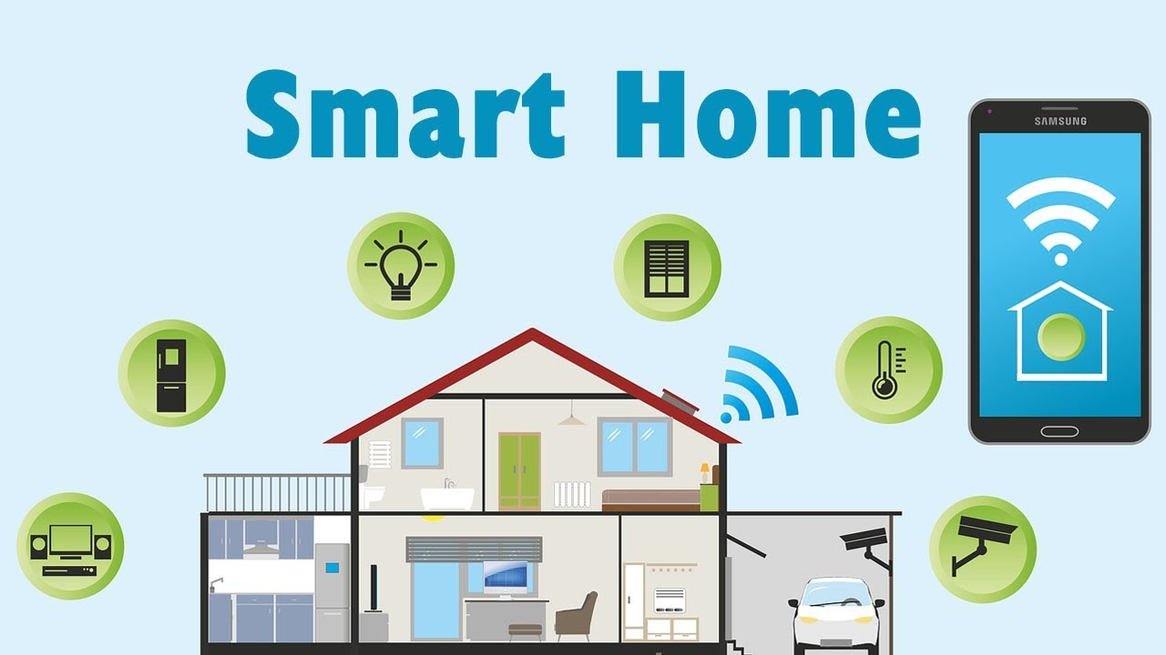

Slide 8
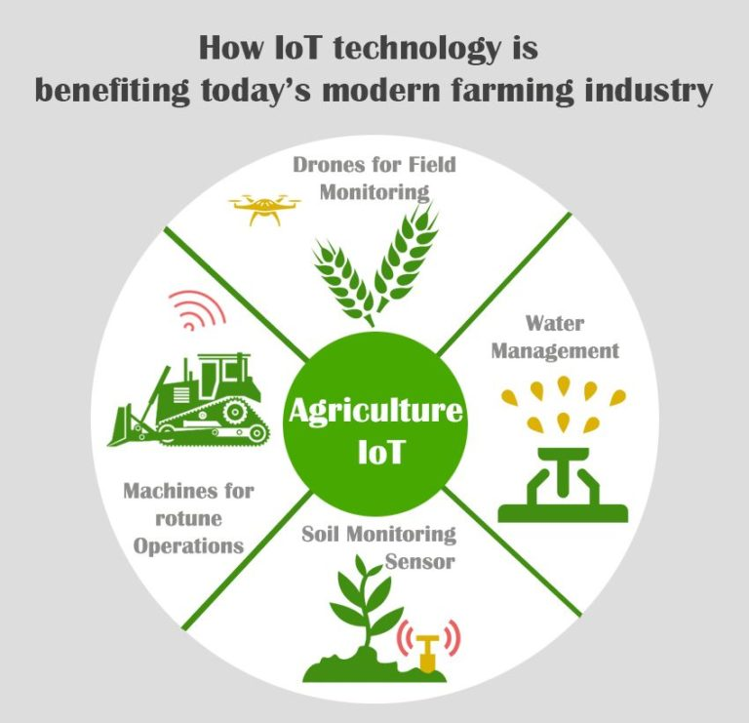

Slide 9
Challenges of IoT
1. Outdated hardware and software.
2. Use of weak and default credentials.
3. Malware and ransomware.
4. Security of autonomous vehicles.
5. Scalability.

Slide 10
What could be the future of IoT?
Increase in Internet participants:
Provides a huge market for device manufacturers.
Increased DDoS attack
Cybercrime will increase and there will be extensive use of IoT devices to facilitate the DDoS Attack.
Reign of Smart Cities
cities will be able to automate, remotely manage, and collect data through visitor kiosk, video camera surveillance, automobile rentals.

Slide 11
Conclusion
The IoT or the Internet of Things has made the lives of the human being straightforward and comfortable. It has made the lives of the people very convenient.
Whereas on the other hand with the increased use of the Internet of Things the treat for security and safety has also increase.

